Slide 1

Advanced Programming For Business Analytics
Miguel Torrealba Schwarz, Julio Berrocal Alvarez, Nicolas Gonzalez Aguirre, Abdur Rahman

Slide 2
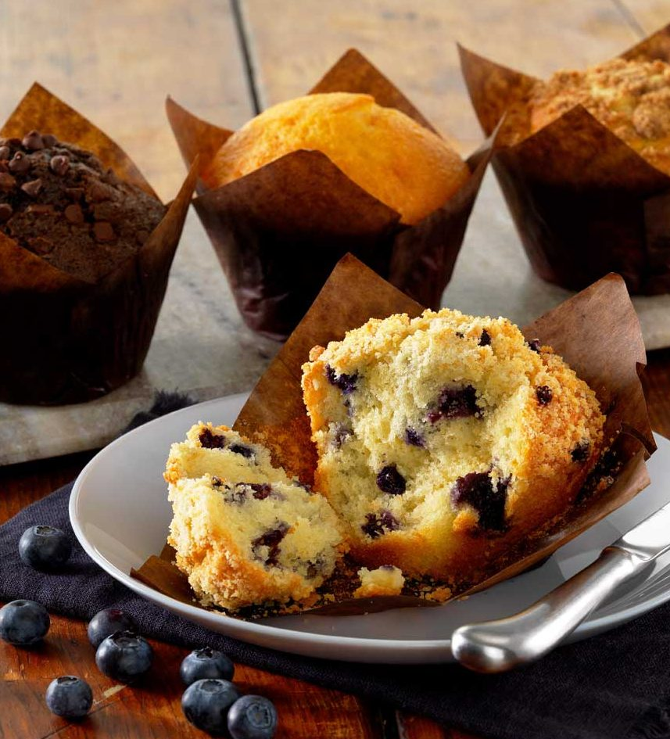
Introduction
Mission: To consistently produce top quality, premium valued bakery products with the taste of hometown goodness in every bite.​
Muffin Town is a leading bakery based in Chelsea, Massachusetts, known for its exceptional baked goods.​
Established in 1978, Muffin Town has grown from a small bakery into a renowned brand recognized for its high-quality products.​
Muffin Town offers a diverse range of baked goods, including muffins, cakes, pastries, and other delicious treats, catering to various tastes and preferences.​
With a nationwide presence, Muffin Town serves both retail consumers and the foodservice industry, providing its products to a wide range of customers across the country.

Slide 3
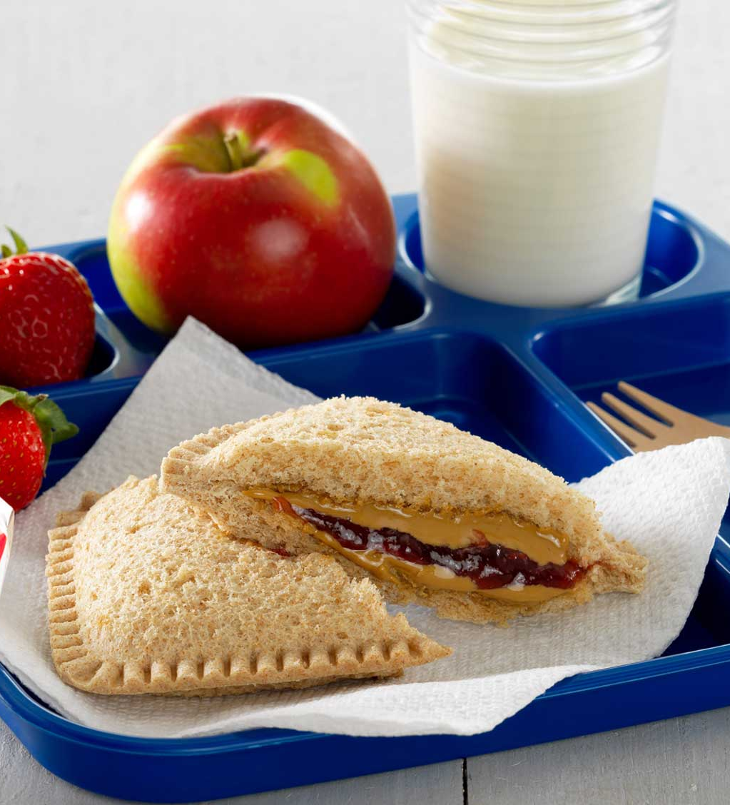
Project Background
Visited Muffin Town's plant in Lawrence to gain insights into their operations and meet with Brian, the key contact.​
Engaged in discussions with Brian to understand his needs and objectives for the project.​
Brian provided Excel files containing data on plant performance for each SKU (Stock Keeping Unit).​
Conducted data cleaning and analysis to prepare the data for further insights.​
Established biweekly meetings with Brian to update him on project progress and gather feedback.​
Developed an Excel template covering the previously shared files and utilized the Gradio library in Python to create a platform for Brian to obtain quick insights on the performance of different plants.​

Slide 4

Input
Muffin Town used several excel sheets to manage the information
Formats​
Units of measurement​
Protocol to entry​
Single source of information​
This led to data that did not match with the needs of the business, complicating analysis
To begin the process of improvement, several conventions were implemented in their process of managing inputs​
Created a single source of information after mapping the process and creating a schema​
Created a Master Data for all SKUs, Production Lines, and capacity​
Created tables to organize information and fed through the primary key​
Validated data through conditional formatting ​
Minimized error and manual input with drop down lists​

Slide 5
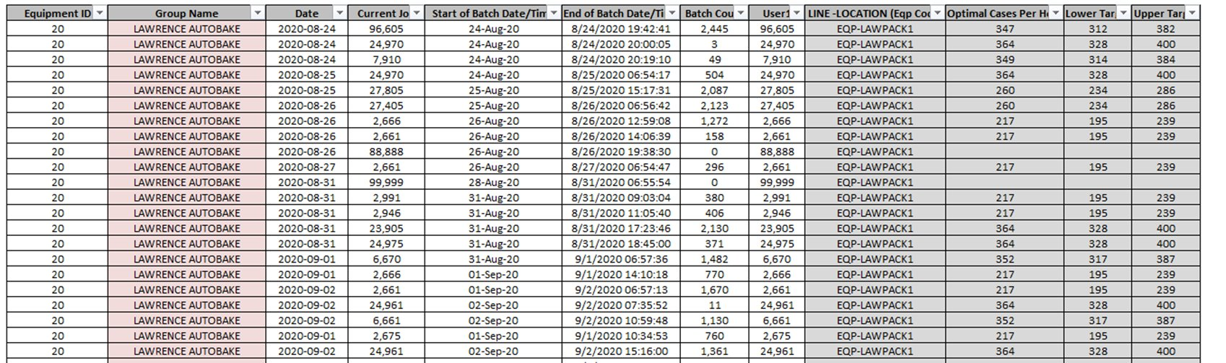
Excel Template
The excel file standard sets the right path for the codes proper run​
Uses color coding to define data type and inputs​
Show flexibility for SKUs increase and other production parameters

Slide 6
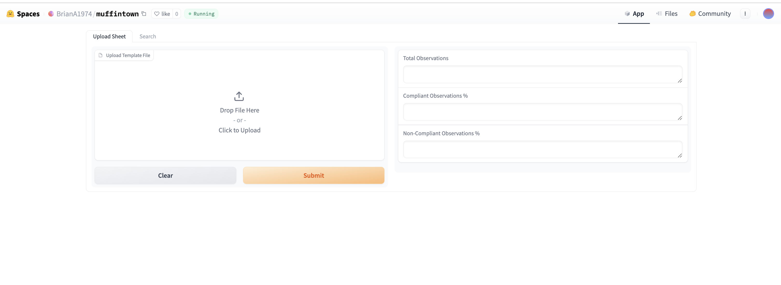
Gradio Layout

Slide 7
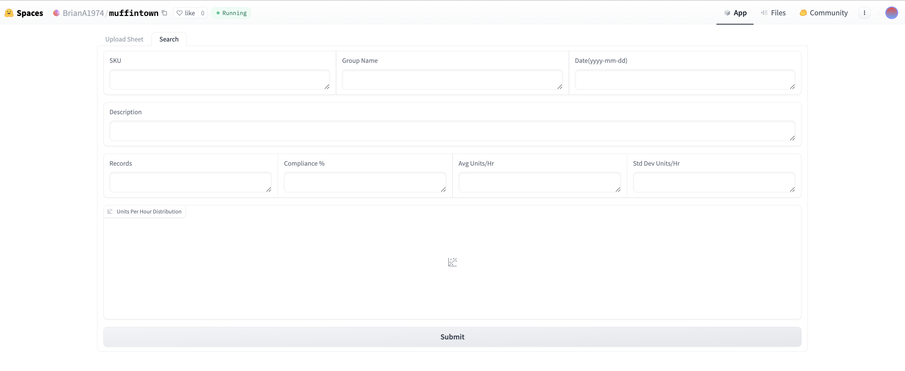
Gradio Layout

Slide 8
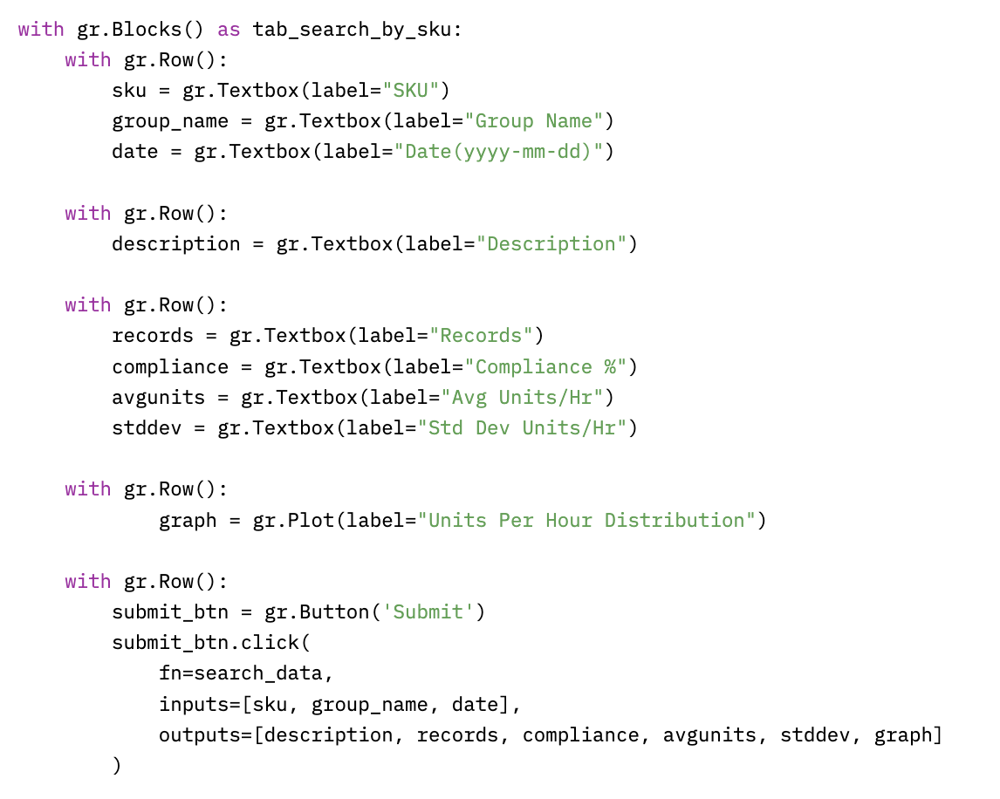
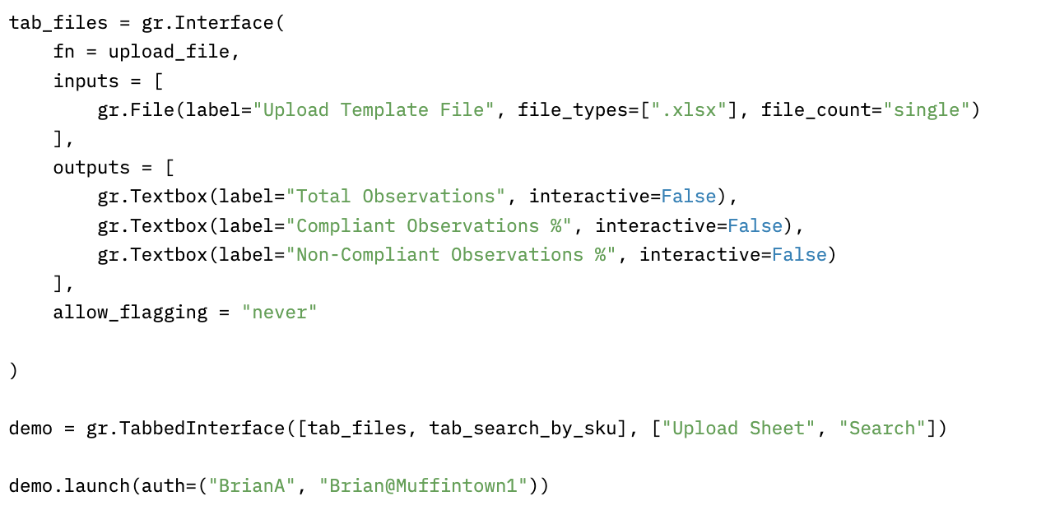
Gradio Layout

Slide 9
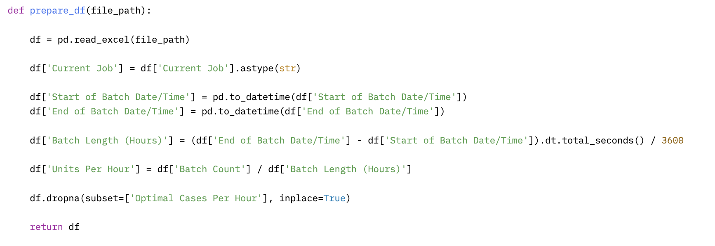
Function prepare_df
Notes:
The function reads an Excel file located at the given file path into a DataFrame using pd.read_excel.​
It converts the 'Current Job' column to strings using .astype(str).​
It converts the 'Start of Batch Date/Time' and 'End of Batch Date/Time' columns to datetime objects using pd.to_datetime.​
It calculates the duration of each batch in hours by taking the difference between 'End of Batch Date/Time' and 'Start of Batch Date/Time', converting it to total seconds, and then dividing by 3600 to get hours.​
It calculates the 'Units Per Hour' by dividing 'Batch Count' by 'Batch Length (Hours)' and stores the result in a new column.​
It drops rows where the 'Optimal Cases Per Hour' column contains missing values using dropna.​
Finally, it returns the modified DataFrame.​

Slide 10
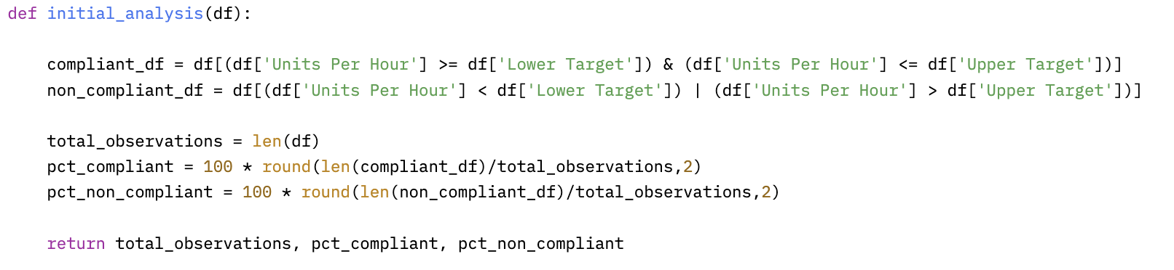
Function initial_analysis
Notes:
Filters the DataFrame `df` to create a new DataFrame `compliant_df` containing rows where the 'Units Per Hour' fall within the range specified by 'Lower Target' and 'Upper Target’. ​
It calculates the total number of observations in the original DataFrame `df` and stores it in the variable `total_observations`.​
It calculates the percentage of observations that are compliant by dividing the length of `compliant_df` by `total_observations`, rounding the result to two decimal places, and multiplying by 100.​
Finally, it returns the `total_observations`, `pct_compliant`, and `pct_non_compliant`.

Slide 11
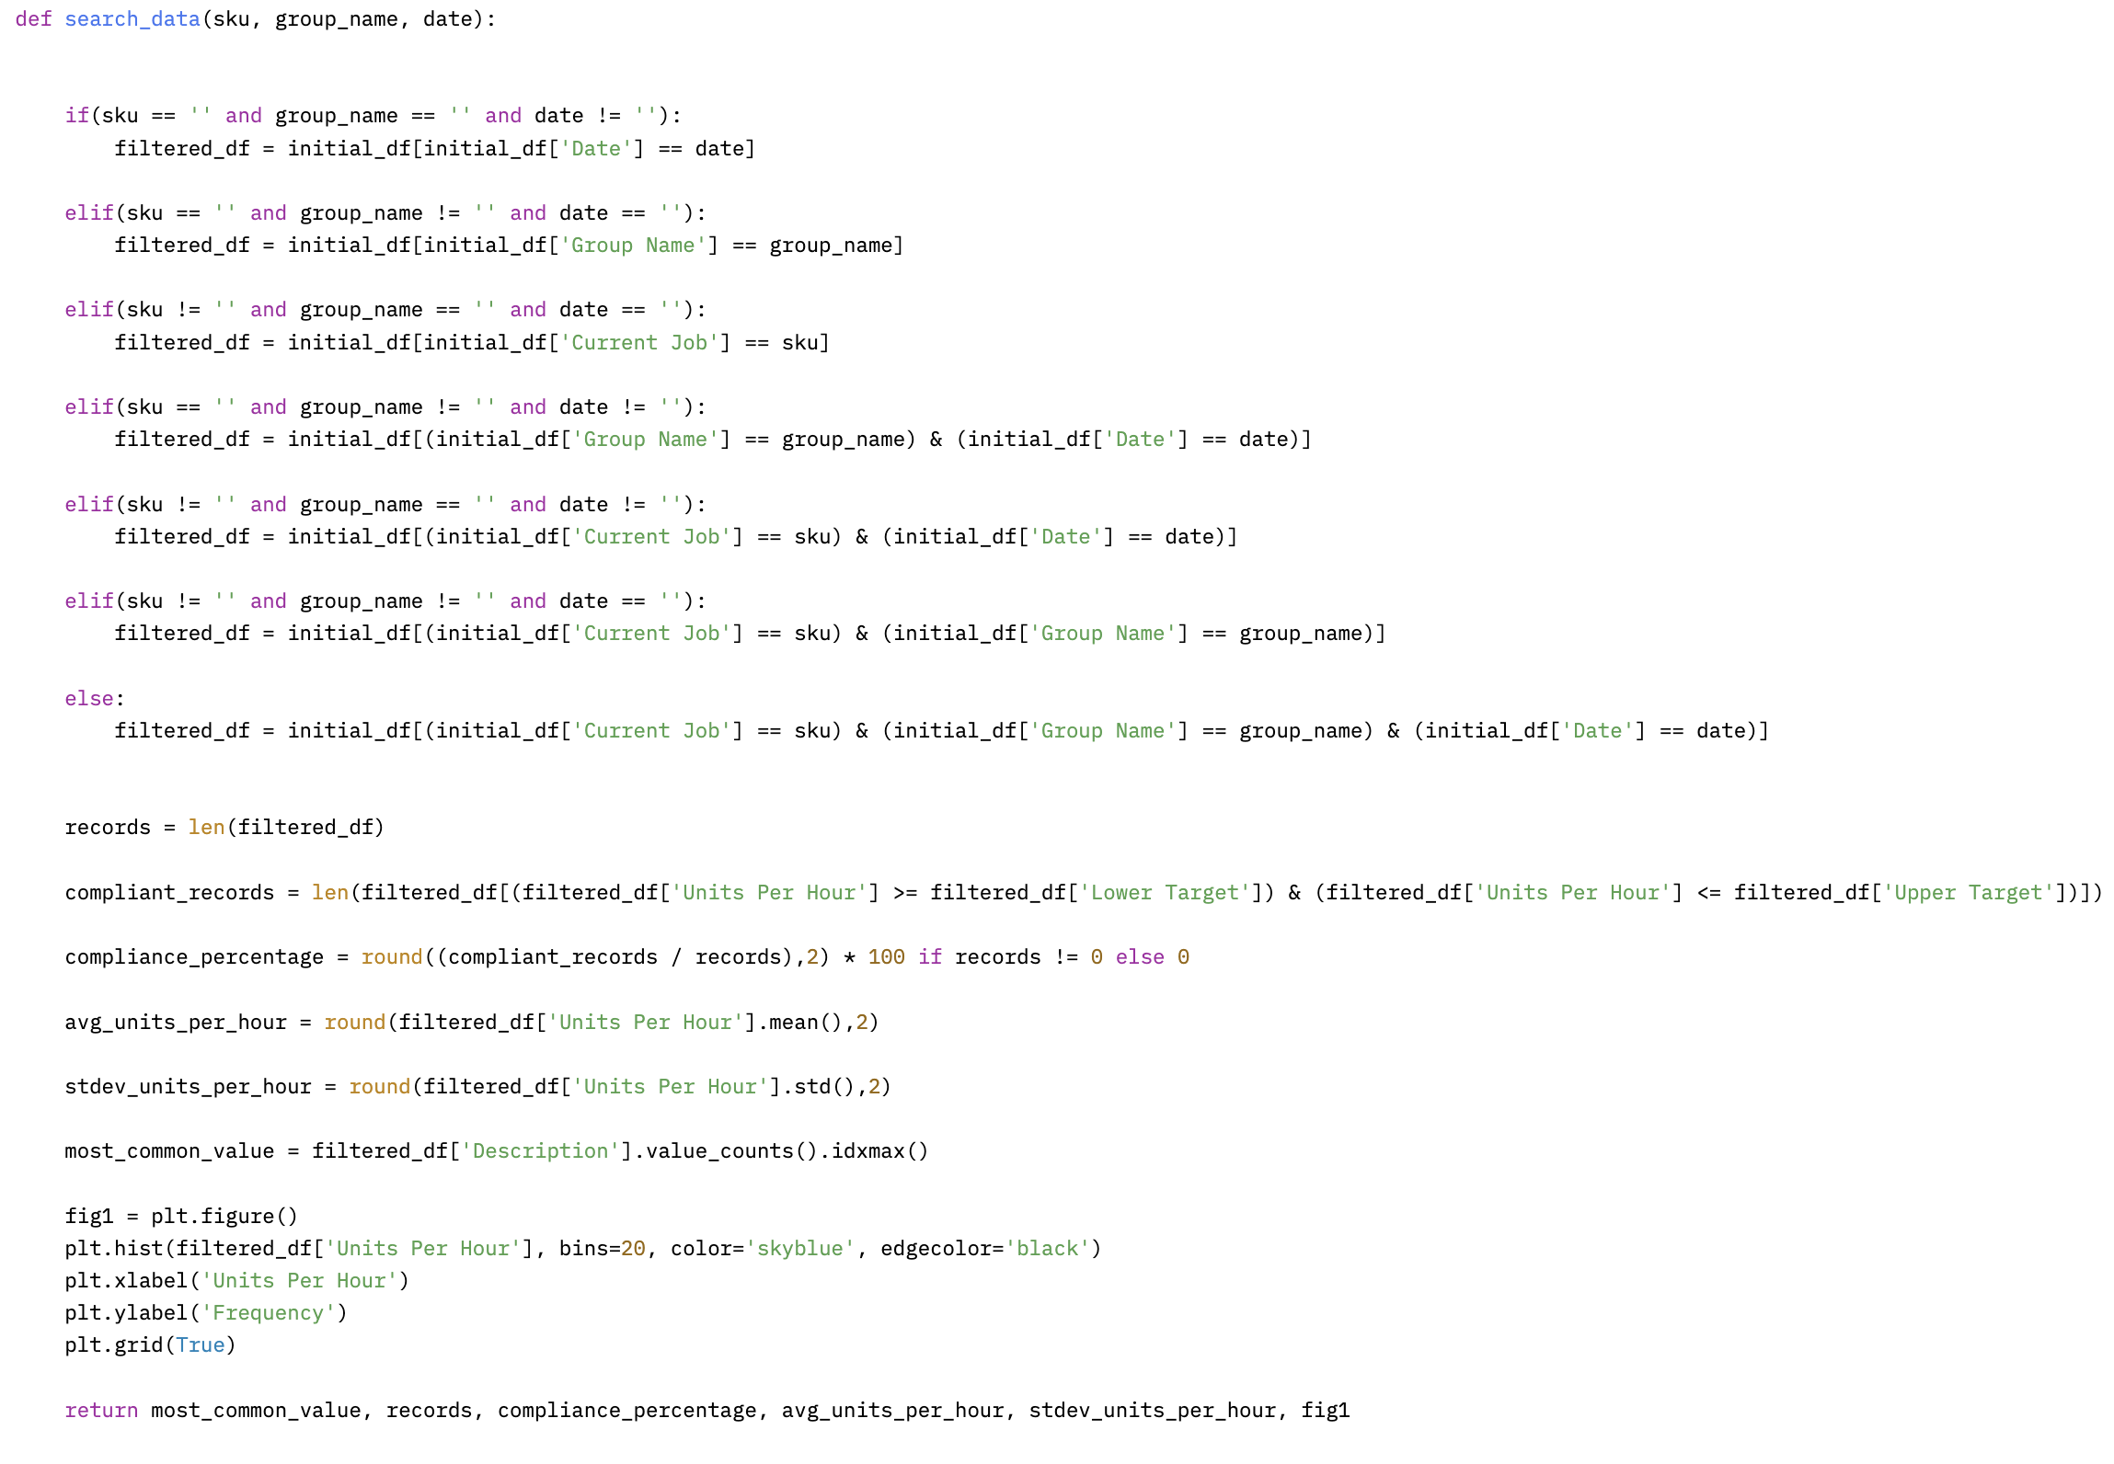
Function search_data

Slide 12
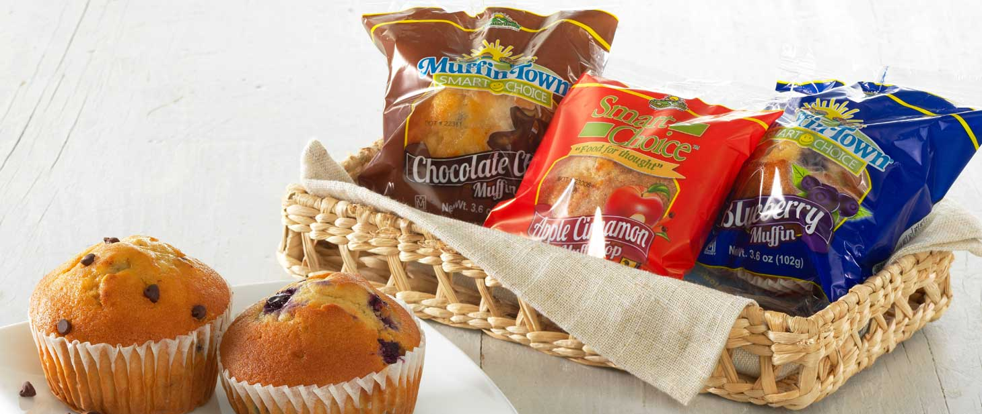
Application Demo
https://huggingface.co/spaces/BrianA1974/muffintown
Notes:
skus = ['96605', '24970’]
group_names = ['LAWRENCE AUTOBAKE', 'LAWRENCE - SW PACK']

Slide 13
Thanks!
Do you have any questions?

